Slide 1
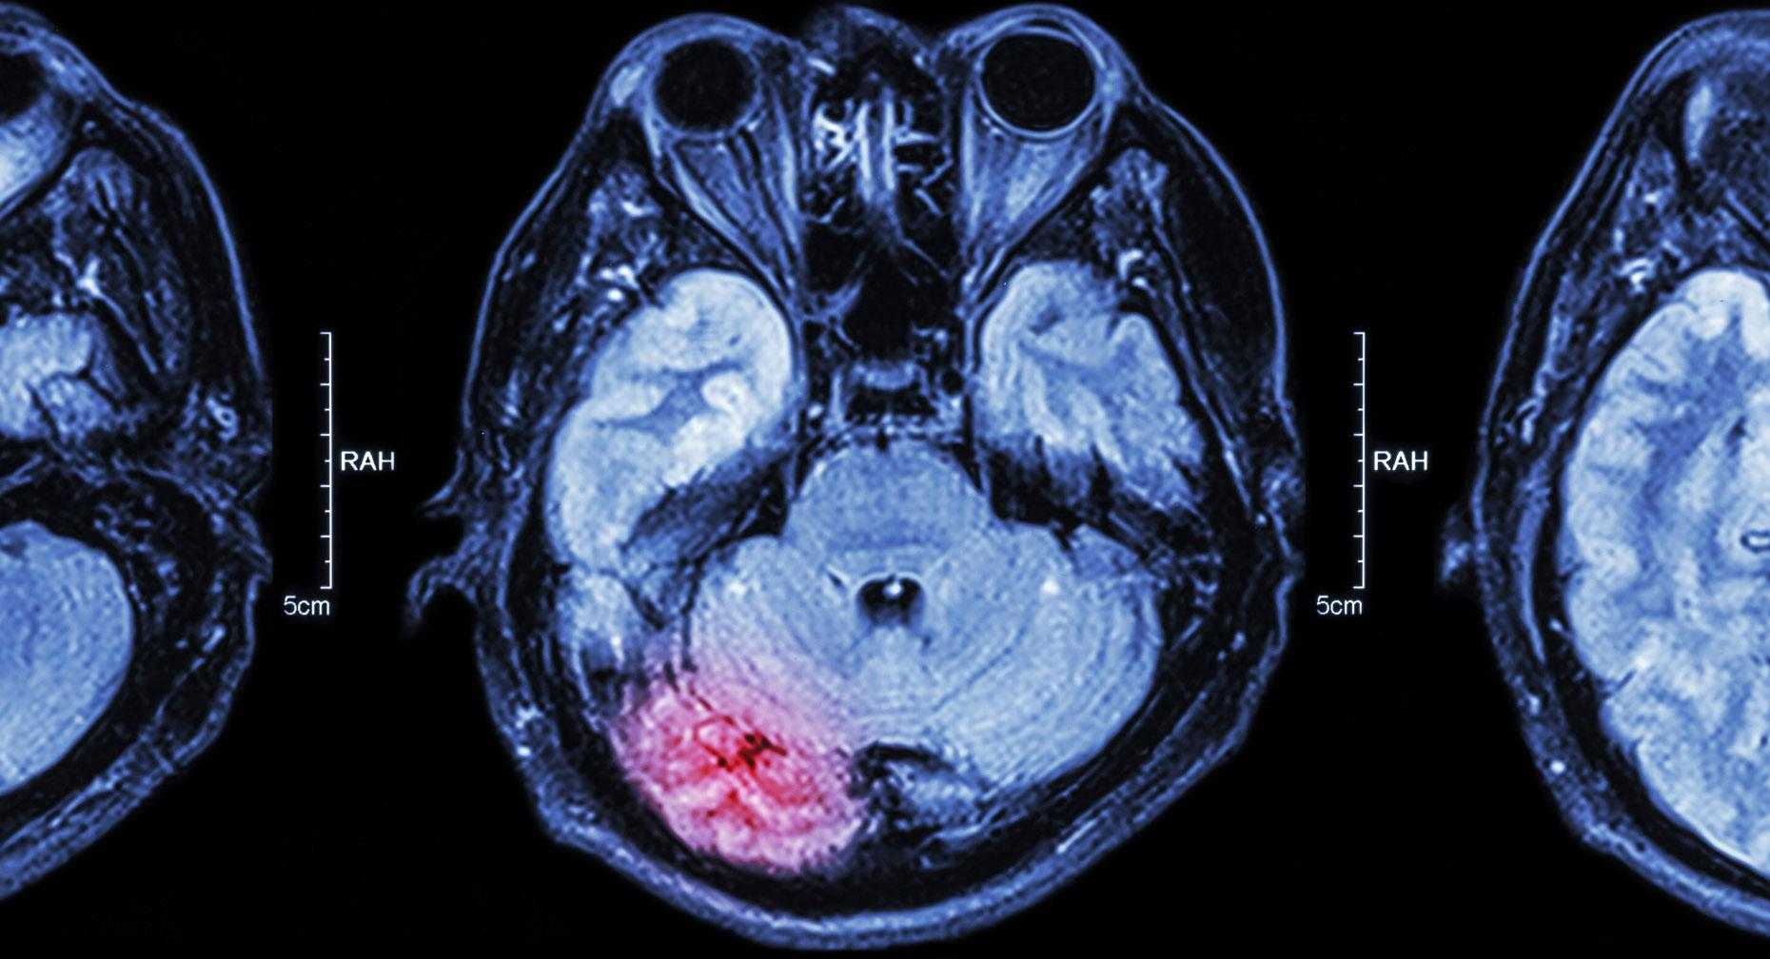
Team Sage
Brain Stroke Prediction
Jerrick Gerald
Renganathan Laxmanan
Sai Dontukurti
Sowmya Maddali

Slide 2
Why brain stroke data?
In the US, stroke is one of the main causes of mortality and disability. A stroke may happen to anybody, regardless of age or background.
Approximately 795,000 individuals in the US suffer strokes each year, and 137,000 of them face death, according to the National Institutes of Health (NIH), US Department of Health and Human Services.
According to the World Health Organization (WHO) stroke is the 2nd leading cause of death globally, responsible for approximately 11% of total deaths.
Ref: https://www.nichd.nih.gov/health/topics/stroke/conditioninfo/risk

Slide 3
About the Dataset
This dataset is used to predict whether a patient is likely to get a stroke based on the input parameters like gender, age, various diseases, and smoking status.
Source: Kaggle.
Each row in the data provides relevant information about the patient.
Gender | Age | Heart_disease | BMI | Hypertension
Avg Glucose Level | Ever_married | Work_Type | Residence_Type | Stroke - Target

Slide 4
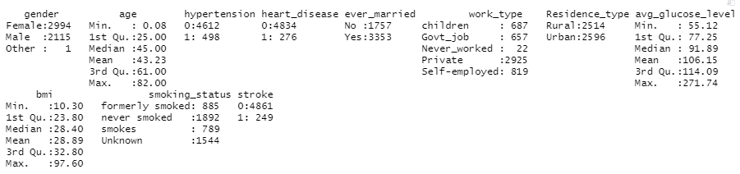
Summary of the dataset

Slide 5
Exploratory Data Analysis

Slide 6
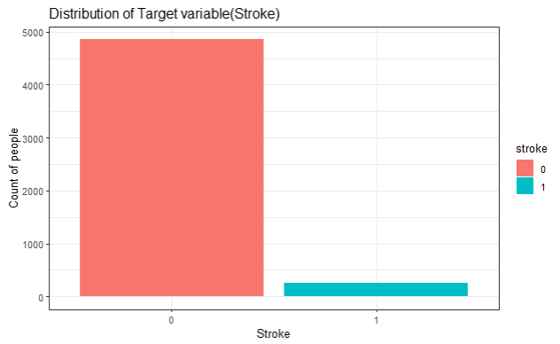
Distribution of the target variable

Slide 7
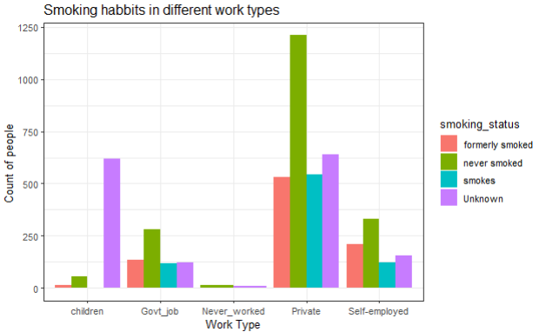
Can the type of the job and smoking habit of a person cause stroke?
This graph is for people who got stroke!

Slide 8
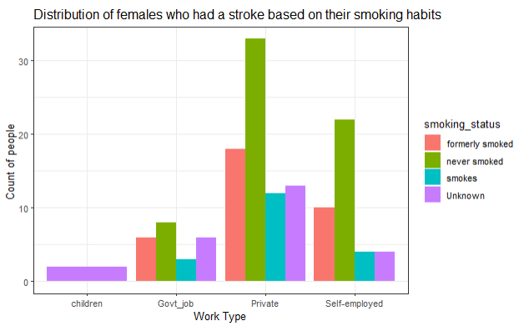
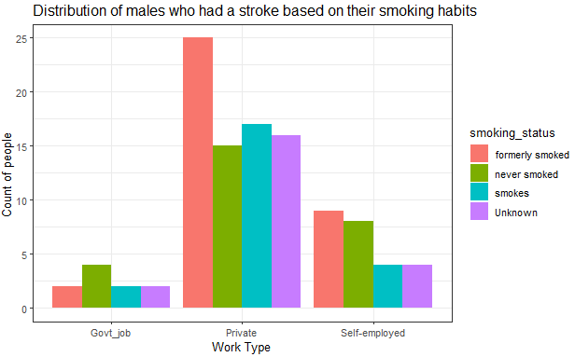
Females
Males

Slide 9
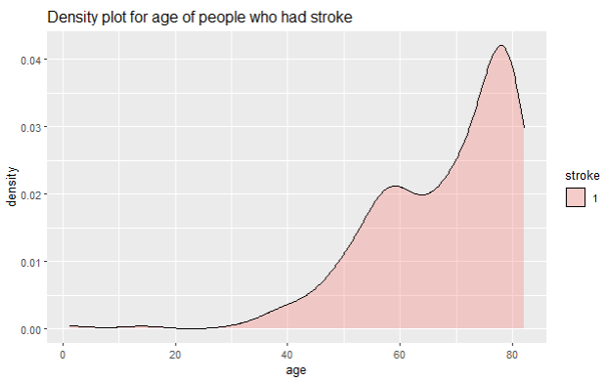
Does aging really cause stroke?

Slide 10
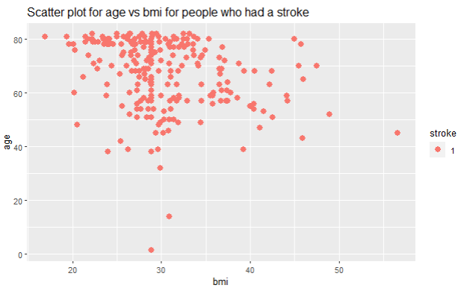
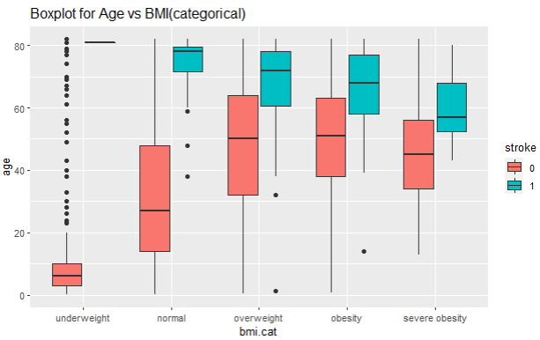
Does aging with any other factor increase the chances of getting a stroke?

Slide 11
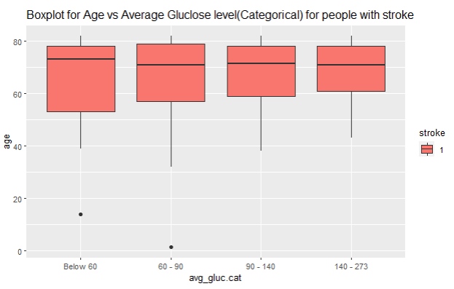
Does age have any effect on other variables?

Slide 12
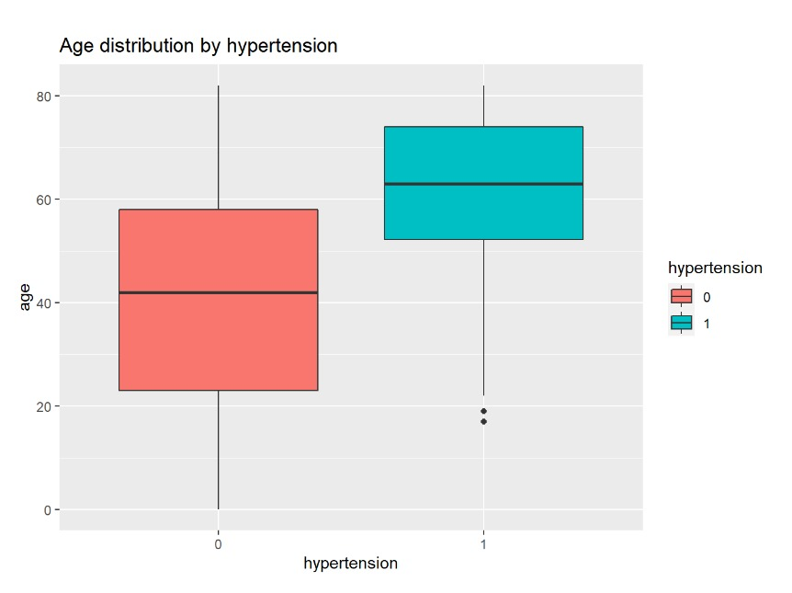
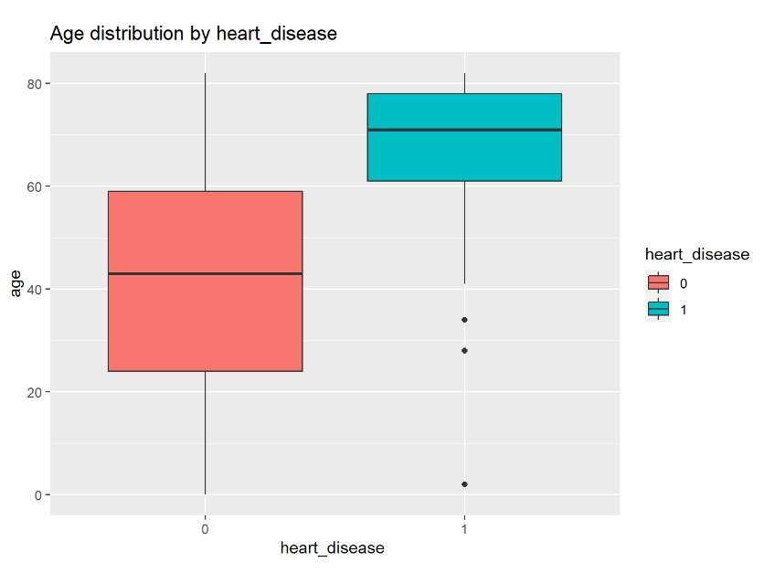

Slide 13
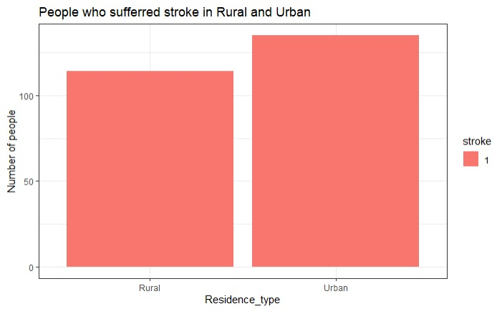
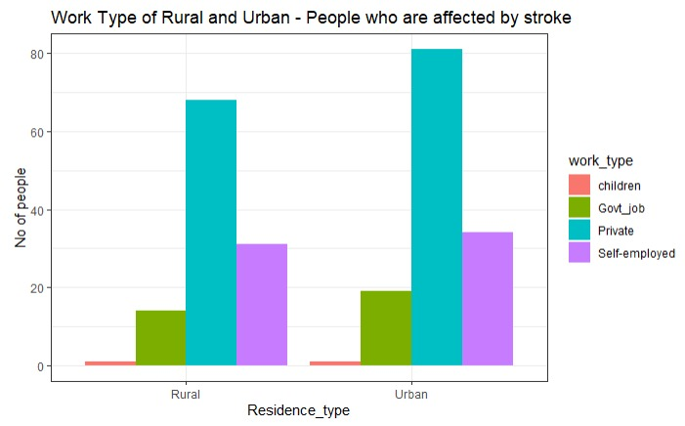
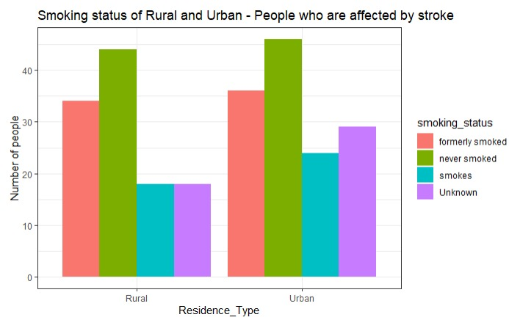
Does residence type cause stroke?
This graph is for people who got stroke!

Slide 14
Statistical Analysis(Chi-Square Test)
TARGET | FEATURES | P- VALUE | DEPENDENT/INDEPENDENT
STROKE | Residence_Type | 0.2983 | INDEPENDENT
STROKE | Work_Type | 5.398e-10 | DEPENDENT
STROKE | Smoking_status | 0.003285 | DEPENDENT
STROKE | Gender | 0.7895 | INDEPENDENT
STROKE | Hypertension | 2.2e-16 | DEPENDENT
STROKE | Heart Disease | 2.2e-16 | DEPENDENT
STROKE | bmi.cat | 3.99e-09 | DEPENDENT
STROKE | avg_gluc.cat | 2.2e-16 | DEPENDENT

Slide 15
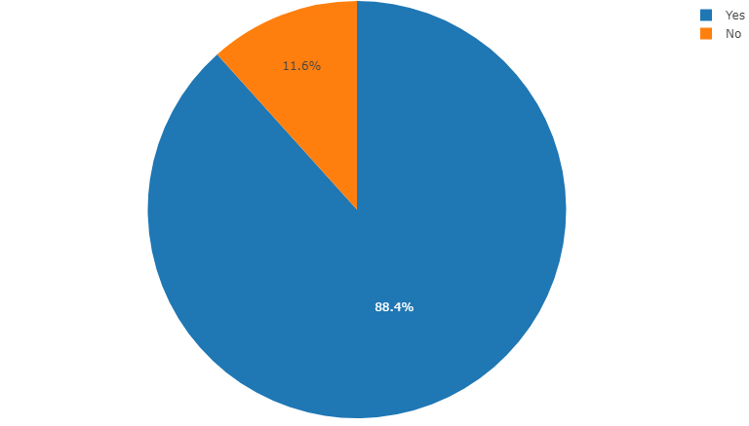
Let’s discuss about a fun finding !! :P
Do you guys think that somebody will get a stroke if they are married? - Lol !!!
Here is the finding - According to this dataset

Slide 16
QUESTIONS?

Slide 17
! THANK YOU !

